Slide 1


RICH. ELEGANT. TIMELESS.
SPANISH RED WINE ANALYSIS
Martisha Owens

Slide 2

Presentation Summary
TOPICS TO COVER
Stakeholder Issue
Data Introduction
Visuals:
Scatterplot
Bar Plot
Strength and Limitations
Recommendation
Improvements

Slide 3
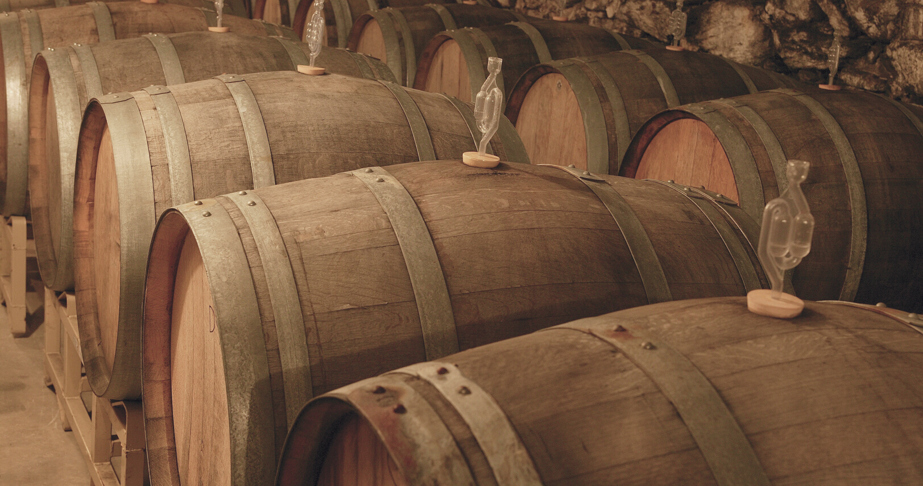
Who is our Stakeholder?
PREDICT THE RATINGS
Help predict the ratings of various red wines using the description metrics provided.
Winemaker: This information could be used for wineries who are crafting together a new blend of wine and would like to predict the potential rating before hand.
Wine Shops: Before purchasing from wineries, distributers could use the model to predict how well the sales would be based on the predicted rating.
Spanish Red Wine Analysis

Slide 4
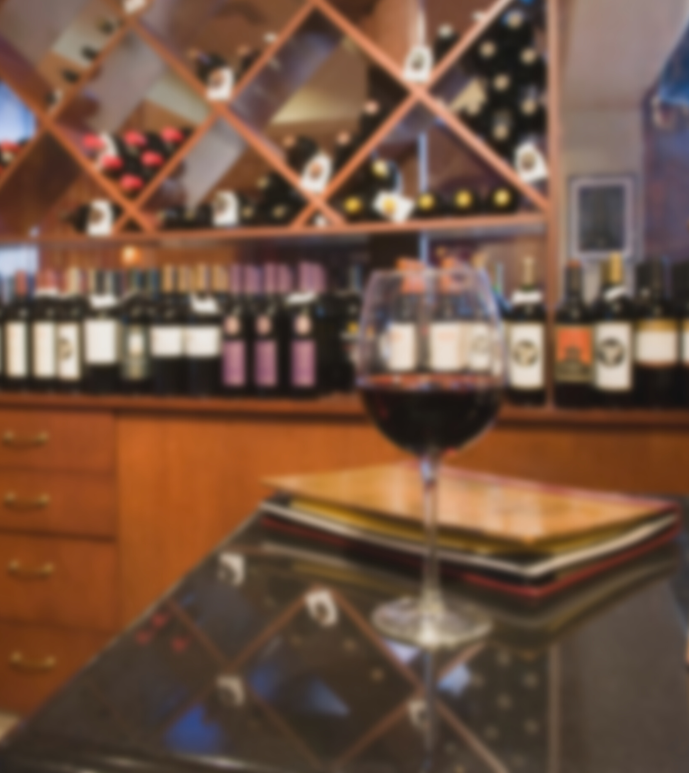
Features
The features include year in which the grapes were harvested, region, price, type of wine variety, body (defined as the richness and weight), and acidity (tartness).
About the Data
Classification
The ratings are a distinct value on a scale of 1 to 5 (pre-adjustment) and therefore and is a classification.
Ratings
Although the ratings from the dataset is in a range from 1 to 5, all of the wine had a rating between 4 to 5. The ratings column was adjusted to use the tenth factor as it's true rating, and fall between the range 1 to 10.
Spanish Red Wine Analysis

Slide 5



Data Adjustments
WHAT DATA WAS DROPPED?
Country
Number of Reviews
Winery
The country data was removed because the model with strictly focused on Spain.
Number of users that reviewed the wine is not a defining feature of the wine itself.
This was done to prevent overcomplicate the model. There were more than 480 different wineries in the data.

Slide 6
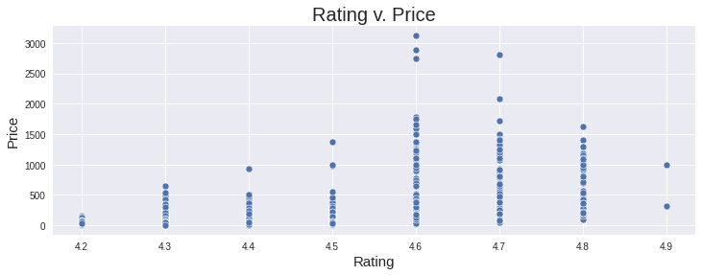
Scatter Plot
Rating had the highest correlation with price. The correlation was 0.51 which is considered high.
With this in mind, I created an exploratory visual that explores the rating of wine based on each pricing.
From the scatter plot below, the higher rated wine is not entirely the most expensive. However, the more expensive wine selects were rated higher than the total average rating of 4.4.
A wine industry could use this informartion to price up the higher rated wine to drive demand.

Slide 7
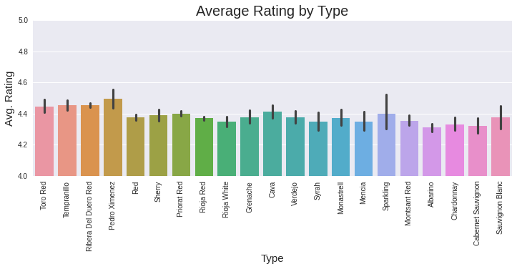
Bar Plot
For this visual the original rating scale was used. However, the average ratings for this visual was limited between the range of 4 and 5.
The wine type Pedro Ximenez had an average rating above all other wine types.
The wine industry could use this information to produce/sell more of this type of wine to the public.
Coming in behind was Toto Red, Tempranillo, and Ribera Del Duero Red.

Slide 8

Strength & Limitations
0.75
Of all the rating, it seems the red wine with rating 3 had the highest prediction rate of 66%.
All the other ratings were correctly predicted at about 33% of the time and incorrectly assumed to have the rating 3.
This could mean that the safest bet when predicting the wine rating was a 3.
0.5
0.25
0
2
3
4
5
6
7
8
Spanish Red Wine Analysis

Slide 9

PCA HYPERTUNED RANDOM FOREST MODEL
46%
The Final Model Accuracy
This is quite low compared to the train accuracy of 96%. This means the model is overcomplicated around the training data and is unable to predict other datasets.
Spanish Red Wine Analysis

Slide 10

Recommendation
In conclusion, I would not recommend my model for predicting Spanish Red Wine rating as is. I believe improvements could be made to increase the accuracy of the test data to match the training data.

Slide 11
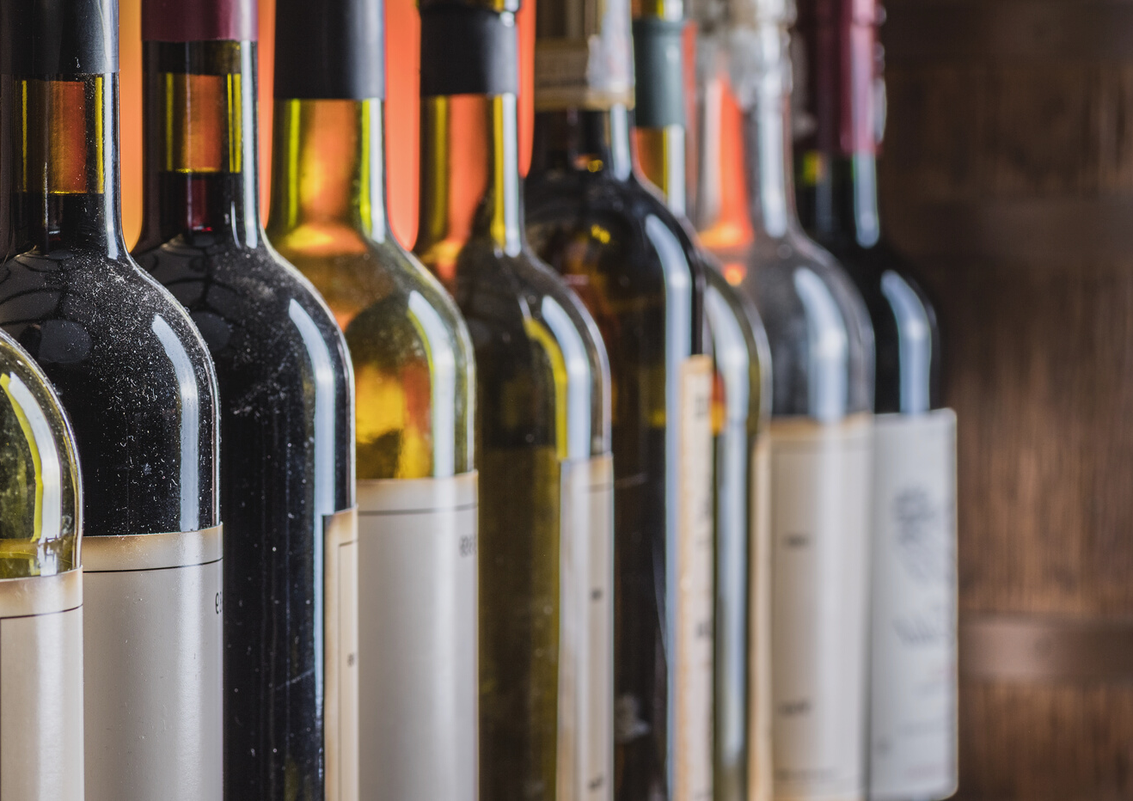
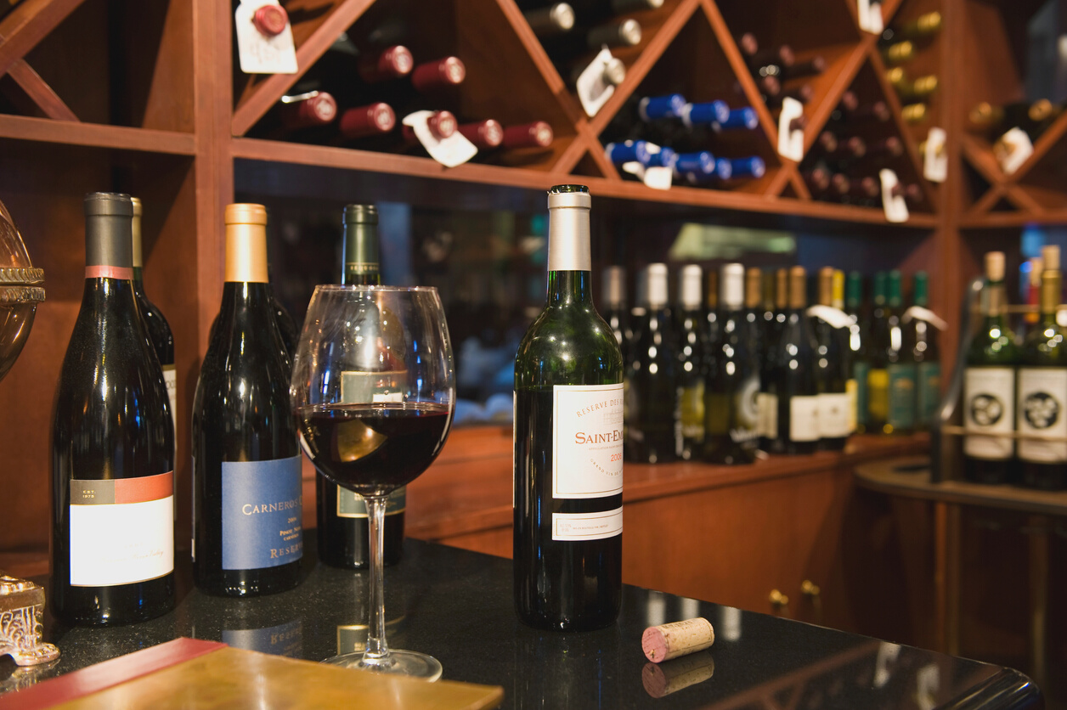
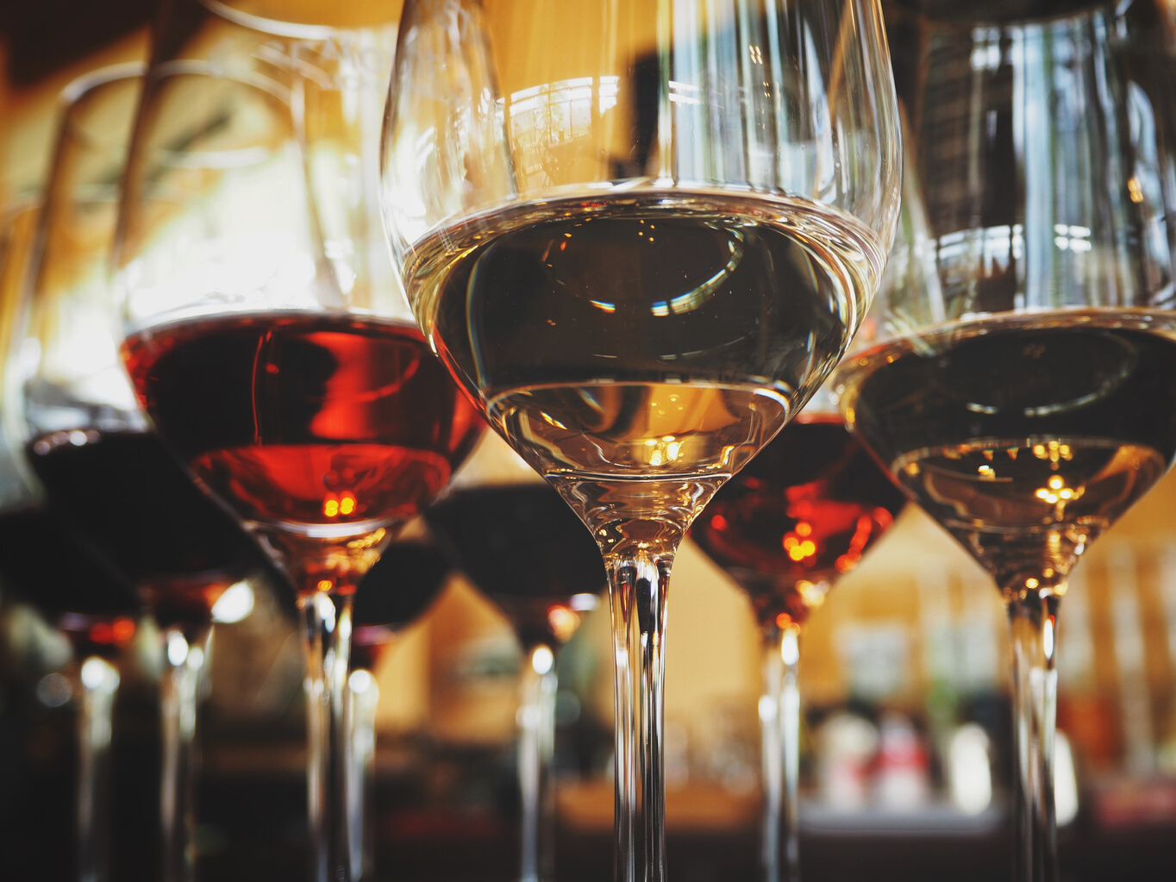
Improvements
More defining features
Further Hypertuning
Simplify
The model was limited to seven unique features. The model could have included features such as sweetness lvl, alcohol %, or dryness.
Could focus on choosing better hypertuning parameters.
Although winery was dropped to prevent overfitting, wine was another feature in the data that had quite a few unique values at 847.

Slide 12

Cheers!
Spanish Red Wine Analysis

